Slide 1
CS 392 - Capstone Project
O2 - Phase 1

Slide 2
GROUP MEMBERS
Aakash Sinha
Deep Parikh
Karanjit Singh Gill
Mohit Raj
NVS Abhilash
Prateek Agarwal
TEAM MEMBERS - G1

Slide 3
AGENDA
What is O₂
Features of O₂
Progress so far
Demo
Technologies used
Roadmap

Slide 4
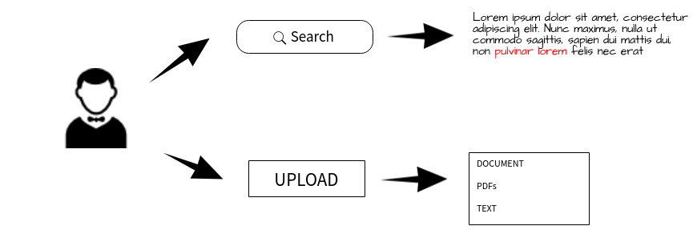
O₂

Slide 5
Search engines search documents related to the keywords typed into the search engines portals within a very quick time period and submit results from best to worst relating to relevance.
The following takes a look at the statistics and facts relating to Search Engines.
84% of submissions are done manually.
45% of searches are keyword searches / phrase queries.
Reference : https://www.optimus01.co.za/search-engine-stats-and-facts/

Slide 6
FEATURES
Document Search Engine.
Semantic Search Capabilities.
User can upload documents of supported format.
Can search .pdf, .doc, .xls, .rtf, .html, .odt, etc .
Can work on both internet and intranet.

Slide 7
PROGRESS
Wireframe design
Data Flow Diagram
MVC Architecture adopted
Front Controller
Research on Elastic Search capabilities
Research on Semantic Analysis

Slide 8
WIREFRAME

Slide 9
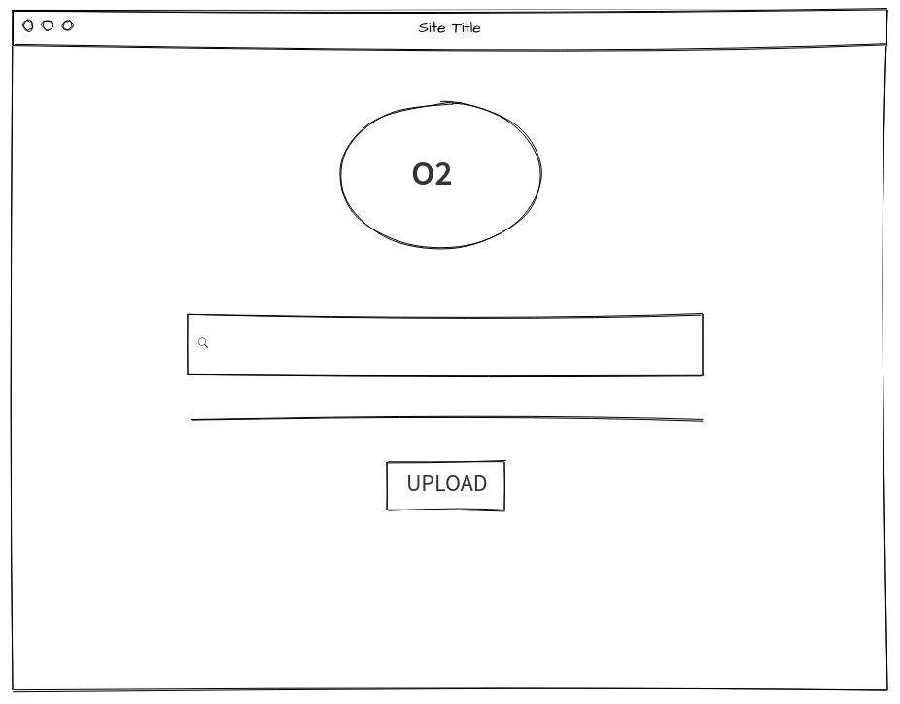

Slide 10
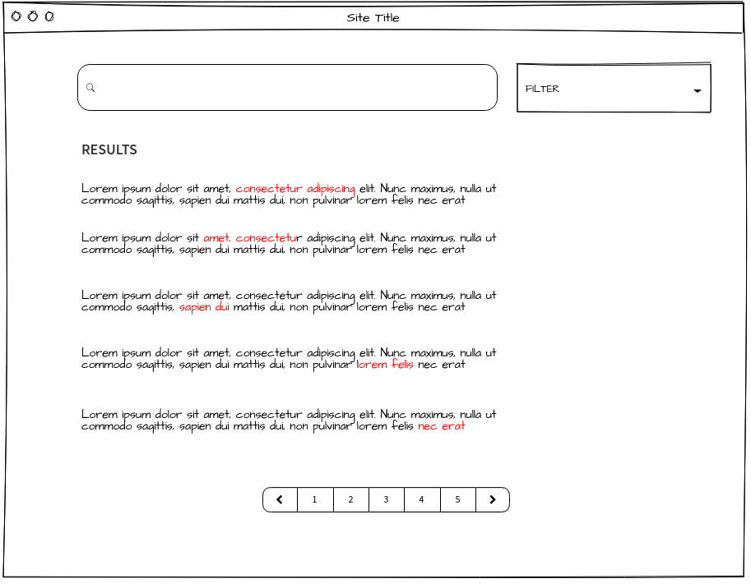

Slide 11
DATA FLOW DIAGRAM

Slide 12
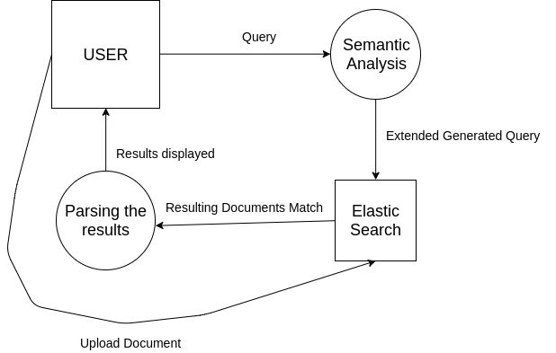

Slide 13
DEMO
Java Servlet application
JSP for sitemap
Shift to Spring framework.
Spring introduction
Development environment : STS
Learning Spring integration for handling API calls for Elastic Search using request mapping and annotations.

Slide 14



TECHNOLOGIES USED
Java Spring Framework (Spring Tool Suite)
Java Server Pages
Java Servlets
Elastic Search
GitHub for project collaboration
Trello & Slack for project management

Slide 15
ELASTIC SEARCH
Elasticsearch is a distributed, RESTful search and analytics engine capable of solving a growing number of use cases
It is Fast !
Uses inverted index
Finite state transducers for full text query
BKD-trees for numeric and Geo Data
It is Scalable
Can run on single node.
Can run on a large cluster. E.g. 300 Machines

Slide 16
ROLES
ROLE | TEAM MEMBER
Elastic Search Integration Semantic Search Capabilities | Karanjit Singh Gill Prateek Agarwal NVS Abhilash
Spring MVC | Deep Parikh Mohit Raj Aakash Sinha

Slide 17
RoadMap
Design Phase :
Wireframing
Application Architecture Design
State Transition Diagram
Basic Servlet implementation
Elastic Search Integration
Semantic Analysis & Query Processing

Slide 18
ELASTIC SEARCH INTEGRATION
Idea is to learn the features and APIs NOT to use as a black box.
Integrate the RESTApi with the Spring Framework

Slide 19
Semantic Search & Query Processing
Research current state-of-the-art techniques in Semantic Search.
Research the existing tools for Semantic Search
Compare trade-offs between different methods and tools and implement / integrate the same.

Slide 20
ANY QUESTIONS ?

